Slide 1
Nonprofit news in the public interest
Serving San Diego’s East County

Slide 2
East County Media supports:
East County Magazine
East County Wildfire & Emergency Alerts

Slide 3
Our reach is broad.
Our news site, www.EastCountyMagazine.org, averages 12 million hits and a half million visits every month, with new stores posted daily.
Our East County Magazine radio show airs on KNSJ, can be accessed by cell phone via a TuneIn app, and heard anywhere on the Internet.
Weekly e-newsletters with free subscriptions drive traffic to our site.
Free wildfire and emergency alerts via e-mail and texts build loyal followers.
Social media posts on Facebook and Twitter engage the community.

Slide 4
Our Mission
Create and support independent public interest news, wildfire and emergency alerts, and community events--keeping people safe and informed while reflecting the rich diversity of San Diego's inland region.

Slide 5
Our news reflects diverse voices and views.

Slide 6
Since 2008, our reporters have covered East County’s breaking news including wildfires, civil unrest, elections, energy projects, immigrant issues, major events and multi-cultural stories.

Slide 7
East County Magazine has won 126 major journalism awards, including:
League of Women Voters Media Award
SPJ First Amendment Award
Gloria Penner Political Reporting Award
Sol Price Prize for Responsible Journalism
James Julian Award for Community Reporting
Many awards from Society for Professional Journalists and San Diego Press Club including investigative reporting, breaking news, multicultural coverage, and more.
SPJ broadcast award for our radio special on the Cedar Fire anniversary

Slide 8
COVID-19 CRISIS COVERAGE
A Facebook Journalism grant funded our coverage of the pandemic’s impacts on communities including minorities, rural areas, small businesses, and more.
Grossmont Healthcare District helped fund our COVID-19 Local Resources section with health information, testing and vaccine locations, grants and loans to help those impacted.

Slide 9
Our news site includes:
NEWS
Top local news
Roundup (state and regional)
World Watch (national and global)
NEWS ISSUES
Business
Crime Beat
Education
Green Scene
Health
Politics
Weather
FEATURES
Bookshelf
Food & Wine
Homes & Gardens
Sports
EVENTS
Arts & Music
Calendar
Festivals & Events
BEST OF EAST COUNTY
Attractions
Photos & Videos of the Week
Weekend Getaways
PEOPLE
Latino Voices
People Power
Refugee Voices
VIEWS
Columns
Reader’s Editorials
WILDFIRES & EMERGENCIES

Slide 10
We also have community sections:

Slide 11
Our resources sections include:
Community contacts and resources in many fields
Guides for COVID-19 resources, local restaurants, farms, and more

Slide 12
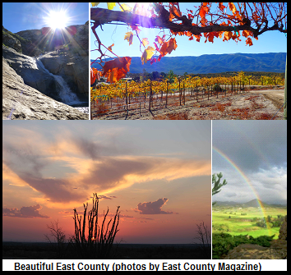
Our East County Guide and Best of East County section highlight attractions in our mountains, deserts, rural and urban areas.

Slide 13
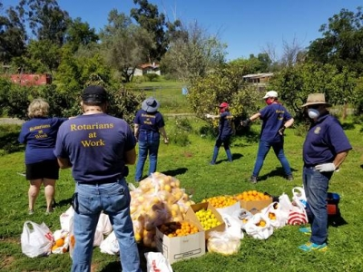
We cover good works by community groups, such as service clubs, food banks, fire-safe councils, tribes, park foundations, and more.

Slide 14
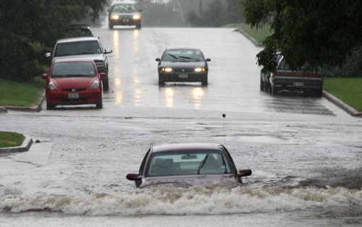
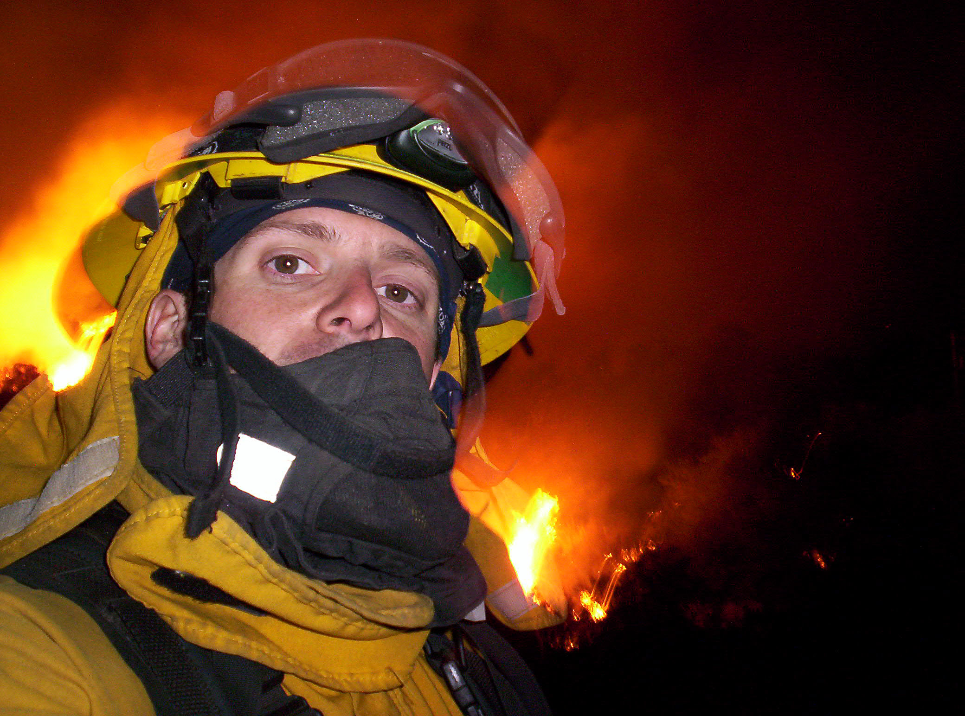
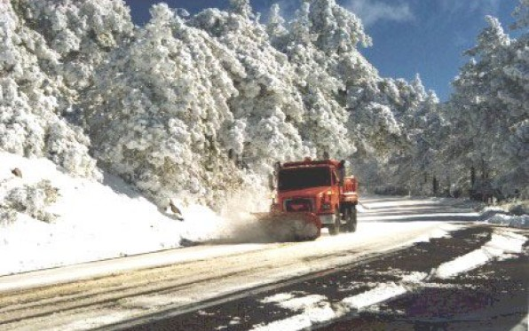
East County Wildfire & Emergency Alerts
Our alerts cover wildfires, flash floods, earthquakes, winter storms, mudslides, highway closures, police actions, toxic spills, missing persons at risk, civil unrest, and more--helping save lives.

Slide 15
ECM reporting has made a positive difference:
After ECM published staffing records proving rural fire stations were closed for months during fire season, the county allocated emergency funds and reopened them.
ECM’s investigative reporting on helicopters dropping heavy items including high-voltage towers dropped by SDG&E led to a worldwide recall of a helicopter part.
ECM’s report on high rates of COVID-19 in Latinos helped spur the county to increase outreach in Spanish and boost testing for these vulnerable communities.
After ECM published video of waste dumped by road crews at Boulder Creek, headwaters of the San Diego River, the county cleaned it up.
Businesses in unincorporated areas would have been ineligible for a county COVID-19 relief program, ECM discovered, due to a rule copied from federal guidelines requiring business licenses--which our county doesn’t issue. The county dropped this requirement the next day.
ECM video of a water district contractor violating a state order and desecrating a Native American sacred site led to an injunction and lawsuit that saved the site.
When the County shut down bars and wineries amid the pandemic, ECM reported that unlike urban bars, rural wineries had not been tied to outbreaks; the county let them reopen outdoors.
A county plan to eliminate protestors in front of the County Administration Building, where Supervisors meet, violated the First Amendment, the ACLU advised after ECM exposed the plan. The County dropped this unconstitutional proposal as a result.
ECM’s report on a county plan to eliminate community planning groups as “red tape” sparked a citizen’s backlash: Supervisors voted 3-2 to save planning groups.

Slide 16
As nonprofit media, we need your support!
How to help:
Donate at www.EastCountyMedia.org/donate. Please consider a sustaining monthly pledge, enabling us to budget for future reporting.
Organizations and businesses can underwrite our alerts or news, or sponsor a special section or project. Grants and grant writers are also needed.
Volunteers are welcome at East County Magazine, our radio show and our events.
Subscribe free to our weekly newsletter and alerts at www.EastCountyMagazine.org. Follow EastCountyAlert on Twitter.

Slide 17
Send us your story ideas. We’re your community media!
Miriam Raftery, Editor
(619)698-7617
Editor@EastCountyMagazine.org

